Slide 1


Disney Supplier Visibility
Transformation Layer Data Model (Draft)
June 2023

Slide 2
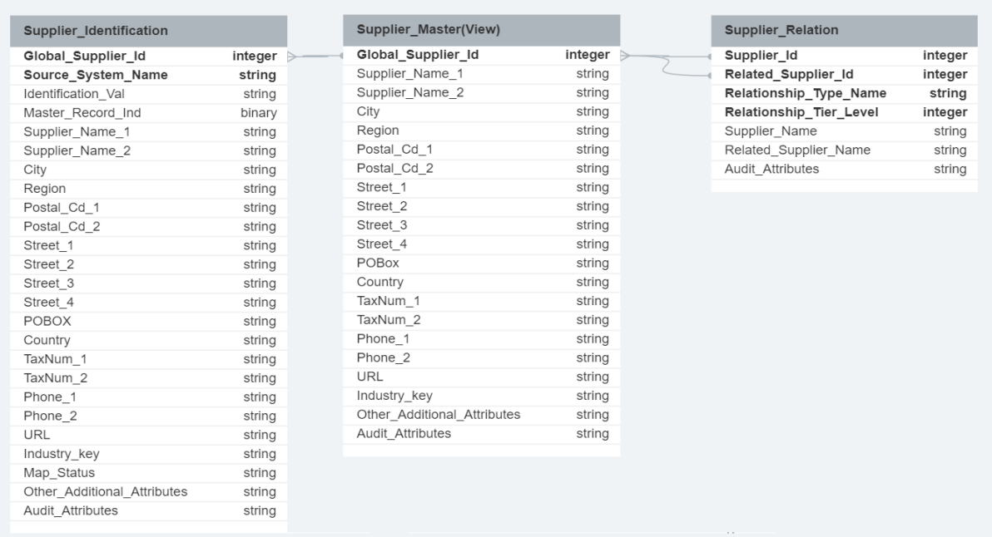
Supplier Visibility - Transformation Layer Data Model (Draft)
We can materialize this view based on the data volumes and expected queries
Additional attributes for process auditing, mapping status through Interos and Screening through Thomson Reuters will be added

Slide 3
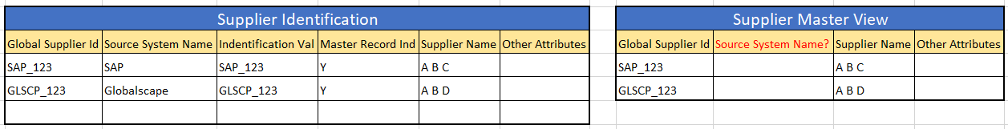
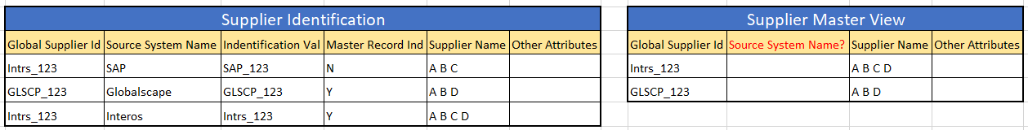
Data Mockups
Scenario 1: When Supplier Data comes first time to Snowflake
SCD Type 1 Treatment for indidual records
Virtual or materialized view for Master_Record_Ind=‘Y’
Scenario 2: When Matching Data comes from Interos
SCD Type 1 Treatment for indidual records

Slide 4
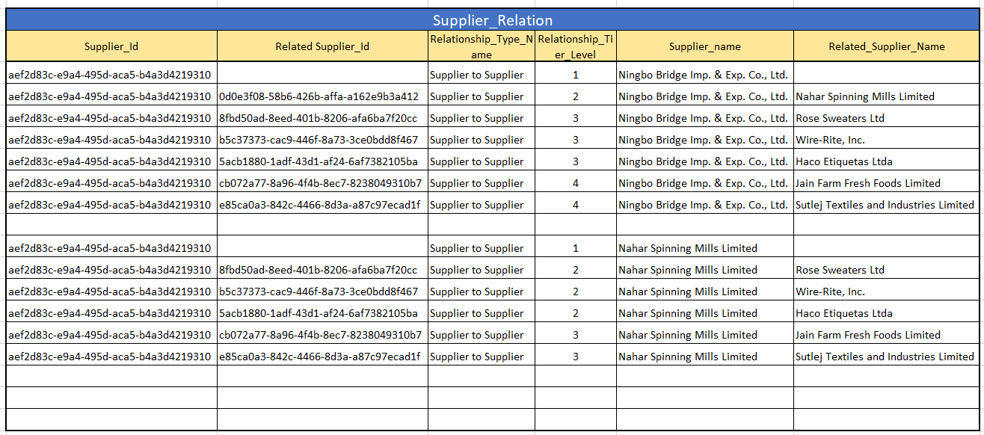
Data Mockups
Supplier to Supplier Relationship Data Mockup

Slide 5
Thank You

